Slide 1

18ECC303J – Computer Communication Networks
Course Credit : 4
Theory : 9 Hours
Reference Text Books
1.Behrouz A. Fehrouzan, “Data communication & Networking”, Mc-Graw Hill, 5th Edition Reprint, 2014.
2. Andrew S. Tanenbaum, “Computer Networks”, Pearson Education India, 5th Edition, 2013.
3. William Stallings, “Data & Computer Communication”, Pearson Education India, 10th Edition, 2014.

Slide 2
Unit 3 – Network Layer
Session 11
Routing Information Protocol-RIP
Session 12
Open Shortest Path First-OSPF
Session 13
Border Gateway Protocol-BGP
Week 9

Slide 3
Unicast Routing Protocols: RIP, OSPF, and BGP
Objectives
Upon completion you will be able to:
Understand distance vector routing and RIP
Understand link state routing and OSPF
Understand path vector routing and BGP

Slide 4
Session 11:RIP
The Routing Information Protocol (RIP) is an intradomain routing protocol used inside an autonomous system. It is a very simple protocol based on distance vector routing.
The topics discussed in this section include:
RIP Message Format Requests and Responses Timers in RIP
RIP Version 2 Encapsulation

Slide 5
RIP
RIP: Routing Information Protocol
Based on distance vector routing
Design considerations
In a AS, RIP deals with routers and networks (links)
The destination in a routing table is a network
The first column defines a network address
The metric used in RIP is hop count
Infinity is defined as 16
Any route in an AS cannot have more than 15 hops

Slide 6
RIP Message Format
Command: 8-bit
The type of message: request (1) or response (2)
Version: 8-bit
Define the RIP version
Family: 16-bit
Define the family of the protocol used
TCP/IP: value is 2
Network Address: 14 bytes
Defines the address of the destination network
14 bytes for this field to be applicable to any protocol
However, IP currently uses only 4 bytes, the rest are all 0s
Distance: 32-bit
The hop count from the advertising router to the destination network

Slide 7
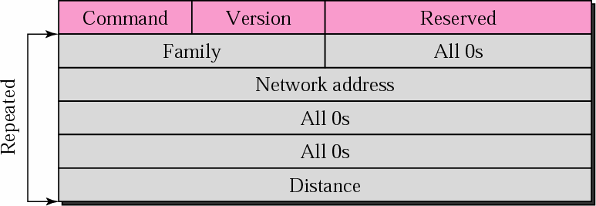
RIP Message Format
igure 13-6

Slide 8
Requests and Response
RIP uses two type of messages
Request and response
Request
Sent by a router that has just come up or has some time-out entries
Can ask specific entries or all entries

Slide 9
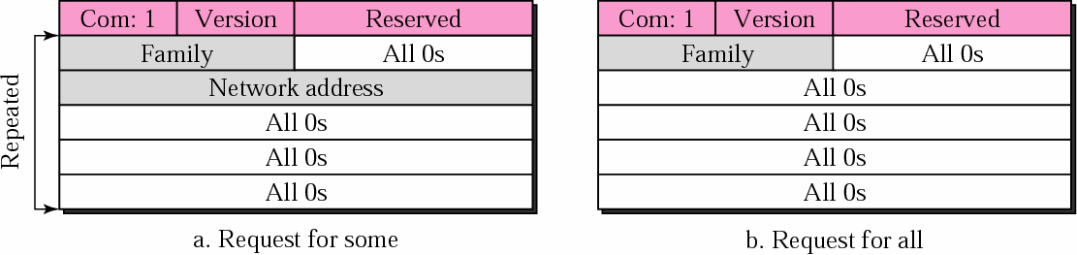
Request Messages
F
igure 13-7

Slide 10
Requests and Response (Cont.)
Response: solicited or unsolicited
A solicited response: sent only in answer to a request
Contain information about the destination specified in the corresponding request
An unsolicited response: sent periodically
Every 30s
Contains information about the entire routing table
Also called update packet

Slide 11
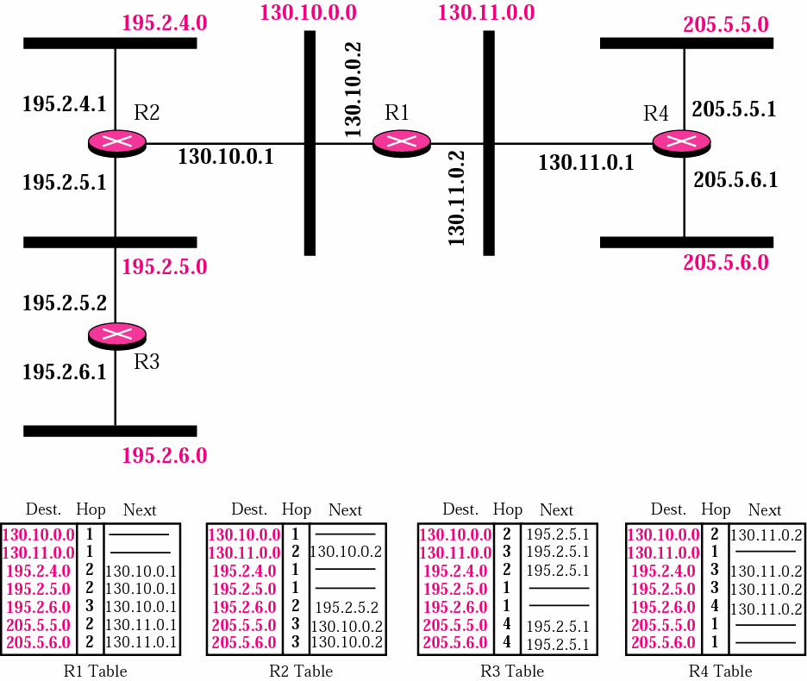
Figure : Example of a Domain Using RIP

Slide 12
Review Question
Following Figure shows the update message sent from router R1 to router R2 in Fig given in the previous slide.
The message is sent out of interface 130.10.0.2
The message is prepared with the combination of split horizon and poison reverse strategy in mind.
Router R1 has obtained information about networks 195.2.4.0, 195.2.5.0, and 195.2.6.0 from router R2.
When R1 sends an update message to R2,
□ Replace the actual value of the hop counts for these three networks with 16 (infinity) to prevent any confusion for R2.
The figure also shows the table extracted from the message.
Router R2 uses the source address of the IP datagram carrying the RIP message from R1 (130.10.02) as the next hop address.

Slide 13
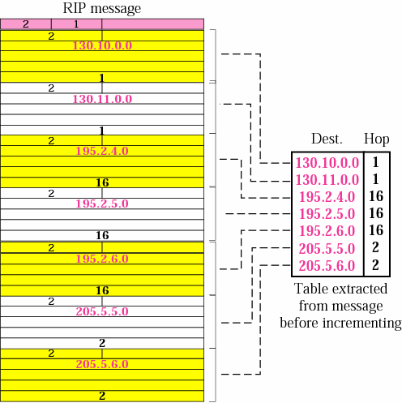
Solution

Slide 14
Timers in RIP
RIP uses three timers
Periodic timer
Expiration timer
Garbage collection timer

Slide 15
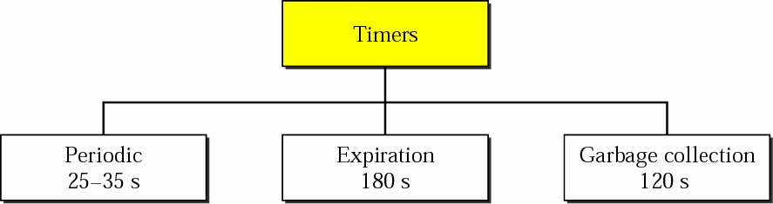
RIP Timers
F
igure 13-10

Slide 16
Periodic Timer
Periodic timer
Control the advertising of regular update message
Although protocol specifies 30 s, the working model uses a random number between 25 and 35 s
□ Prevent routers update simultaneously

Slide 17
Expiration Timer
Govern the validity of a route
Set to 180 s for a route when a router receives update information for a route
If a new update for the route is received, the timer is reset
In normal operation, this occurs every 30 s
If timer goes off, the route is considered expired
The hop count of the route is set to 16, which means
destination is unreachable

Slide 18
Garbage Collection Timer
When a route becomes invalid, the router does not immediately purge that route from its table
It continues advertise the route with a metric value of 16
A garbage collection timer is set to 120 s for that route
When the count reaches zero, the route is purged from the table
Allow neighbors to become aware of the invalidity of a route prior to purging

Slide 19
Review Question
A routing table has 20 entries.
It does not receive information about five routes for 200 seconds.
How many timers are running at this time?

Slide 20
Solution
The timers are listed below:
Periodic timer: 1
Expiration timer: 20 - 5 = 15
Garbage collection timer: 5

Slide 21
RIP Version 2
Does not augment the length of the message of each entry
Only replace those fields in version 1 that were filled with 0s with some new fields

Slide 22
RIP Version 2
New fields
Routing Tag: carries information such as the autonomous system number
Enable RIP to receive information from an exterior routing table
Subnet mask: carries the subnet mask (or prefix)
RIP2 support classless addressing and CIDR
Next-hop address: show the address of the next hop

Slide 23
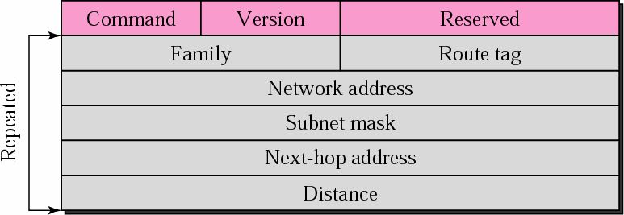
RIP-v2 Format
F
igure 13-16

Slide 24
Classless Addressing
The most important difference between the two versions
classful v.s. classless addressing
RIPv1 uses classful addressing
The only entry in the message format is the
network address (with a default mask)
RIPv2 support classless addressing
Adds one filed for the subnet mask

Slide 25
Authentication
Protect the message against unauthorized advertisement
The first entry of the message is set aside for authentication information
Family field = FFFF₁₆
Not used for routing information but for authentication
Authentication type
Define the method used for authentication
Authentication data
Contain the actual authentication data

Slide 26
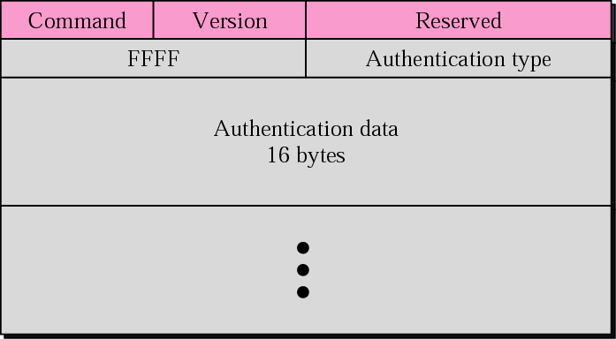
Authentication
F
igure 13-17

Slide 27
Multicasting
Version 1 of RIP uses broadcasting to send RIP message to every neighbor
All the routers and the hosts receive the packets
RIP version 2
Uses the multicast address 224.0.0.9 to multicast RIP message only to RIP routers in the network

Slide 28
Encapsulation
RIP message are encapsulated in UDP user datagram
The well-known port assigned to RIP in UDP is port 520

Slide 29
Session:12 OSPF
The Open Shortest Path First (OSPF) protocol is an intradomain routing protocol based on link state routing. Its domain is also an autonomous system.
The topics discussed in this section include: Areas
Metric
Types of Links
OSPF Packets
Link State Update Packet Encapsulation

Slide 30
Areas
OSPF divides an autonomous system into areas
To handle routing efficiently and in a timely manner
A collection of networks, hosts, and routers all contained within an autonomous system
Thus, an autonomous system can be divided into many different areas
All networks inside an area must be connected

Slide 31
Areas (Cont.)
Routers inside an area flood the area with
routing information
At the border of an area, special routers called
area border routers
Summarize the information about the area and sent it to other areas

Slide 32
Areas (Cont.)
Among the area inside an autonomous system is a special area called backbone
All of the areas inside an AS must be connected to the backbone
The routers inside the backbone are called the
backbone routers
A backbone router can also be an area border router

Slide 33
Areas (Cont.)
If the connectivity between a backbone and an area is broken
A virtual link must be created by the administration through alternate (lengthy) path
Each area has an area identification
The area identification of the backbone is zero

Slide 34
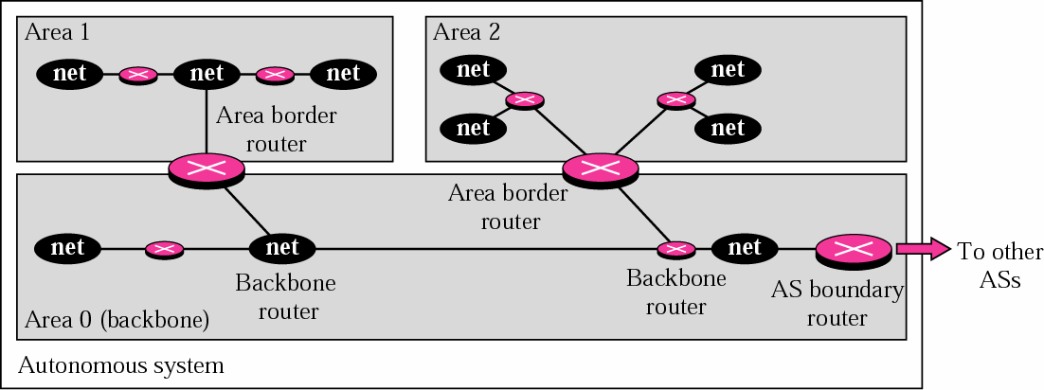
Areas in an Autonomous System
F
igure 13-18

Slide 35
Metrics
OSPF allows the administrator to assign a cost, called the metric, to each route
Metric can be based on a type of service
Minimum delay
Maximum throughput
A router can have multiple routing tables
Each based on a different type of service

Slide 36
Types of Links
In OSPF, a connection is called a link
Four types of links
Point-to-point
Transient
Stub
Virtual

Slide 37
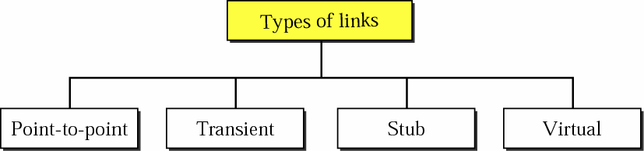
Types of Links
F
igure 13-19

Slide 38
Point-to-Point Link
Connect two routers without any other host or router in these two routers
Example
Telephone line
T-line
Graphically representation
The routers are represented by nodes
The link is represented by a bidirectional edge
The metric
Usually the same at the two ends

Slide 39

Point-to-Point Link
F
igure 13-20

Slide 40
Transient Link
A network with several routers attached to it
Data can enter through any of the routers and leave through any router
Example
All LANs and some WANs with two or more routers

Slide 41
Transient Link (Cont.)
Graphically representation
Figure b in the next slide. However, it is
Not efficient: each router need to advertise the neighborhood of four other routers
For a total of 20 advertisement
Not realistic: there is no single network (link) between each pair of routers
There should be only one network that serves as a crossroad between all five routers

Slide 42
Transient Link (Cont.)
Reality: each router should be connected to every router through one single network
The network is represented by a node
However, network is not a machine
Cannot function as a router
Solution: one of the routers acts as a single network
This router has a dual purpose: a true router and a
designated router
The link is represented as a bidirectional edge
Figure c in the next slide

Slide 43
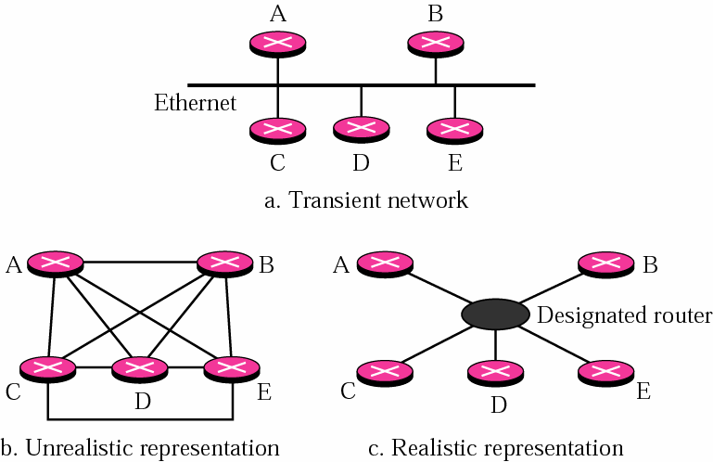
Transient Link
F
igure 13-21

Slide 44
Stub Link
A network that is connected to only one router
Data packet enter and leave through this only one router
A special case of transient network
Graphically representation
The router as a node
The designated router as the network
Note, the link is only one-directional
From the router to the network
Because the network is the end point in the graph representation
See the following third slides

Slide 45
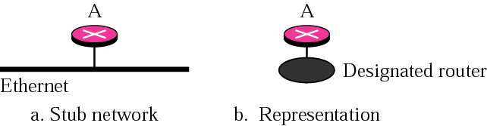
Stub Link
F
igure 13-22

Slide 46
Virtual Link
When the link between two routers is broken
The administrator may create a virtual path between them using a longer path and may go through several routers

Slide 47
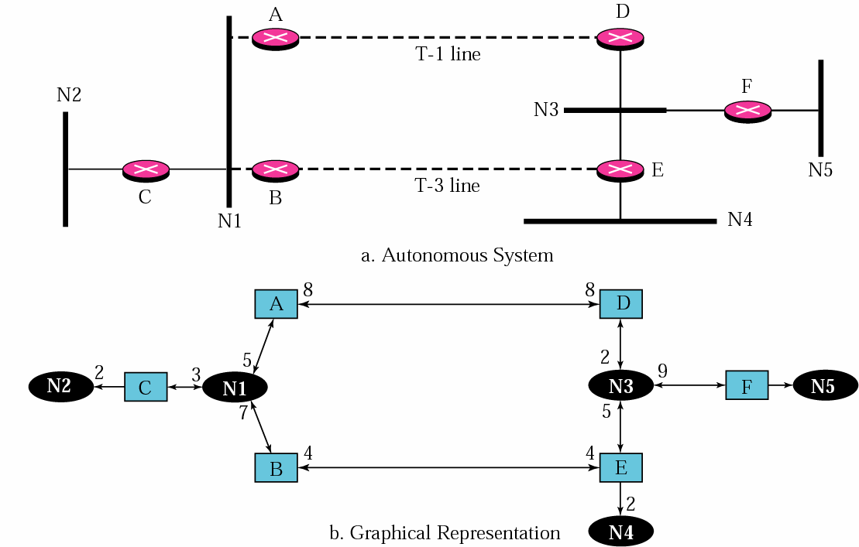
Figure
Example of an AS and its graphical representation in OSPF

Slide 48
Types of Packets
OSPF uses five different packets
Hello packet
Database description packet
Link state request packet
Link state update packet
Router link
Network link
Summary link to network
Summary link to AS boundary router
External link
Link state acknowledgment packet

Slide 49
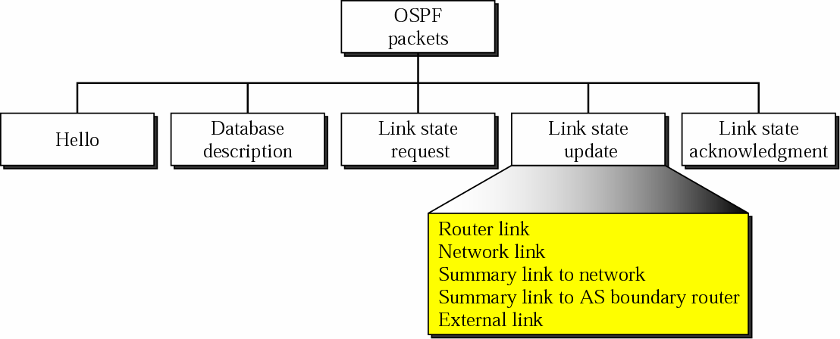
Types of OSPF Packets
F
igure 13-33

Slide 50
Common Header
All OSPF packets share the same header
Version: 8-bit
The version of the OSPF protocol. Currently, it is 2
Type: 8-bit
The type of the packet
Message length: 16-bit
The length of the total message including the header
Source router IP address: 32-bit
The IP address of the router that sends the packet

Slide 51
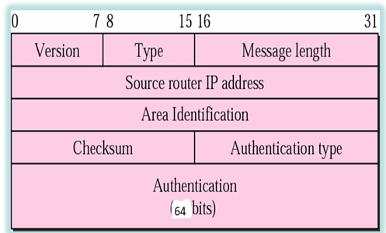
OSPF Common Header
F
igure 13-34

Slide 52
Common Header (Cont.)
Area identification: 32-bit
The area within which the routing take place
Checksum: 16-bit
Error detection on the entire packet excluding the authentication type and authentication data field
Authentication type: 16-bit
Define the authentication method used in this area
0: none, 1: password
Authentication: 64-bit
The actual value of the authentication data
Filled with 0 if type = 0; eight-character password if type = 1

Slide 53
Hello Message
OSPF uses the hello message to
Create neighborhood relationships
Test the reachability of neighbors
First step in link state routing
It must first greet its neighbors

Slide 54
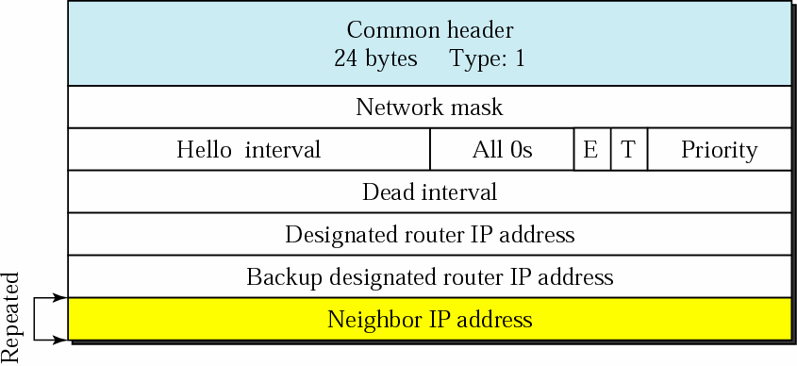
Hello Packet
F
igure 13-35

Slide 55
Hello Packet Format
Network mask: 32-bit
Define the network mask of the network over which the hello message is sent
Hello interval: 16-bit
Define the number of seconds between hello message
E flag: 1-bit
If it is set, the area is a stub area
T flag: 1-bit
If it is set, the router supports multiple metrics

Slide 56
Hello Packet Format (Cont.)
Priority
The priority of the router. Used for the selection of the designated router
The router with the highest priority is chosen as the designated router
The router with the second highest priority is chosen as the backup designated router
If it is 0, the router never wants to be a designated or backup designated router

Slide 57
Hello Packet Format (Cont.)
Dead interval: 32-bit
The number of seconds before a router assumes that a neighbor is dead
Designated router IP address: 32-bit
Backup designated router IP address: 32-bit
Neighbor IP address: a repeated 32-bit field
A current list of all the neighbors from which the sending router has received the hello message

Slide 58
Database Description Message
When a router is connected to the system for the first time or after a failure, it needs the complete link state database immediately
Thus, it sends hello packets to greet its neighbors
If this is the first time that the neighbors hear from the router, they send a database description packet

Slide 59
Database Description Message (Cont.)
The database description message does not contain complete database information
It only gives an outline, the title of each line in the database
The newly router examines the outline and find out which lines it does not have
Send one or more link state request packets to get full information about that particular link
The content of the database may be divided into several message

Slide 60
Database Description Message (Cont.)
When two routers want to exchange database description packets
One of them acts as master
The other is the slave

Slide 61
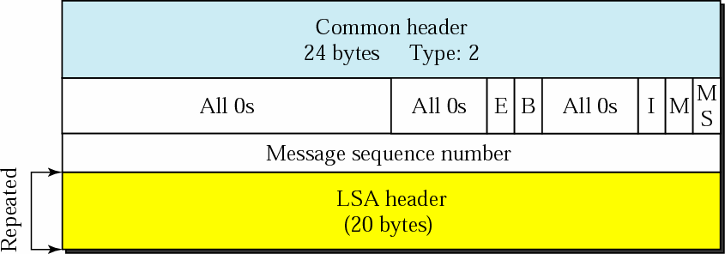
Database Description Packet
F
igure 13-36

Slide 62
Database Description Message Format
E flag: 1-bit
Set to 1 if the advertising router is an autonomous boundary router
B flag: 1-bit
Set to 1 if the advertising router is an area border router
I flag: 1-bit, the initialization flag
Set to 1 if the message is the first message
M flag: 1-bit, more flag
Set to 1 if this is not the last message

Slide 63
Database Description Message Format (Cont.)
M/S flag: 1-bit, master/slave flag
Indicate the origin of the packet. Master = 1, Slave = 0
Message sequence number: 32-bit
Contain the sequence number of the message
LSA header: 20-bit
Used in each LSA(Link State advertisement)
The format of this header is discussed in the link state update message
□ Only give the outline of each link
It is repeated for each link in the link state database

Slide 64
Link State Request Packet
Sent by a router that needs information about a specific route or routes
Answered with a link state update packet
Used by a newly connected router to request more information after receiving the database description packet

Slide 65
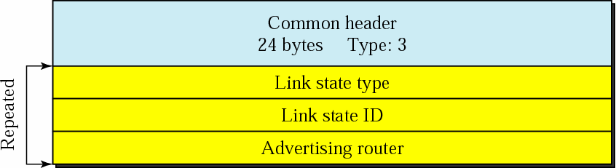
Link State Request Packet
F
igure 13-37

Slide 66
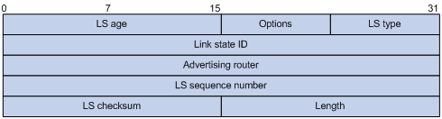
LSA Header (OSPF Update carries LSAs)

Slide 67
LSA Header Fields
LS age—Time, in seconds, elapsed since the LSA was originated. An LSA ages in the LSDB (added by 1 per second), but does not age during transmission.
LS type—Type of the LSA.
Link state ID—The contents of this field depend on the LSA's type.
LS sequence number—Used by other routers to judge new and old LSAs.
LS checksum—Checksum of the LSA except the LS age field.
Length—Length in bytes of the LSA, including the LSA header.

Slide 68
Link State Acknowledgment Packet
OSPF forces every router to acknowledge the receipt of every link state update packet
Make routing more reliable
Format
Common header
Link state header

Slide 69

Link State Acknowledgment Packet
F
igure 13-49

Slide 70
Encapsulation
OSPF packets are encapsulated in IP datagram
OSPF contains the acknowledgment mechanism for flow and error control
Doe not need a transport layer protocol to provide these services

Slide 71
Session:12 PATH VECTOR ROUTING
Path vector routing is similar to distance vector routing. There is at least one node, called the speaker node, in each AS that creates a routing table and advertises it to speaker nodes in the neighboring ASs..
The topics discussed in this section include:
Initialization Sharing Updating

Slide 72
Path Vector Routing
Why distance vector routing and link state routing are not good candidates for interdomain routing?
Mostly because of scalability
Intractable when the domain of operation becomes large

Slide 73
Path Vector Routing (Cont.)
Distance vector routing
Unstable if there is more than a few hops in the domain
Link state routing
An internet is usually too big for this routing method
Need a huge amount of resources to calculate routing table
Create heavy traffic because of flooding
Solution
Path vector routing

Slide 74
Path Vector Routing (Cont.)
There is one node in each AS to act on behalf of the entire AS
Called it speaker node
The speaker node in an AS
Creates a routing table
Advertises the routing table to speaker nodes in the neighboring ASs

Slide 75
Path Vector Routing (Cont.)
Similar to distance vector routing
Except, only speaker nodes in each AS can communicate with each other
Furthermore, a speaker node advertises the path
□ Not the metric of the nodes

Slide 76


Initialization
At the beginning, each speaker node can know only the reachability of nodes inside its AS
A speaker in an AS share its table with immediate neighbors
When a speaker node receives a two-column tables, update its table
Add the nodes that are not in its routing table
Add its own AS and AS that sent the table

Slide 77
Loop Prevention
Path vector routing can avoid the instability of distance vector routing and the creation of loops
When a router receives a message
Check if its AS is in the path list
If yes, looping is involved
□ Drop the message

Slide 78
Policy Routing
Policy routing can be easily implemented through path vector routing
Path vector routing lists all the ASs of each path
Once a router receives a message, it can check the path.
If one of the AS listed in the path is against its policy,
It can ignore that path and that destination
Does not update its routing table with this path
Does not send this message to its neighbors
Thus, path vector routing are not based on the
smallest hop count or the minimum metric
Based on the policy imposed on the router by the administrator

Slide 79
Optimum Path
The optimum path is the path that fits the organization
Criteria may be: hop count, security and safety, reliability
Path vector routing can achieve optimum path by looking for a path best for the organization
Since all the AS are listed in the path

Slide 80
Session -13_BGP
Border Gateway Protocol (BGP) is an interdomain routing protocol using path vector routing. It first appeared in 1989 and has gone through four versions.
The topics discussed in this section include: Types of Autonomous Systems
Path Attributes BGP Sessions
External and Internal BGP Types of Packets
Packet Format Encapsulation

Slide 81
BGP
BGP: Border Gateway Protocol
An inter-autonomous system routing protocol
Based on the path vector routing method

Slide 82
Types of Autonomous Systems
The Internet is divided into hierarchical domains called autonomous systems (ASs)
A large corporation manages its own network is an AS
AS can be classified into three categories
Stub
Multihomed
Transit

Slide 83
Stub AS
Has only one connection to another AS
Interdomain data traffic in a stub AS can be either created or terminated
Cannot pass through a stub AS
A stub AS is either a source or a sink
Example
A small corporation or a small ISP

Slide 84
Multihomed AS
Has more than one connection to another AS
But it is still only a source or sink for data traffic
There is not transient traffic
Does not allow data coming from one AS and going to another AS to pass through
Example
A large corporation connected to more than one regional AS but does not allow transient traffic

Slide 85
Transit AS
A multihomed AS and allow transient traffic
Example
National and international ISPs

Slide 86
CIDR
BGP supports Classless Interdomain Routing addresses
The address and the prefix length are used in updating message

Slide 87
Path Attributes
In general, the path is presented as a list of AS
Actually, the path is presented as a list of attributes
The list of attributes help the receiving router make a better decision when applying its policy

Slide 88
Path Attributes (Cont.)
Attributes are divided into two categories: well-known and
optional
Well-known: one that every BGP router should recognize
Mandatory: must appear in the description of a route
e.g., ORIGIN: the source of the routing information (RIP or OSPF)
e.g., AS_PATH: the list of AS through which the destination can be reached
e.g., NEXT_HOP: the next router to which data packet should be sent
Discretionary
Must be recognized by each router
But is not required to be included in every update message

Slide 89
Path Attributes (Cont.)
Optional: one that need not be recognized by every router
Transitive
Must be passed to the next router by the router that has not implemented this attribute
Nontransitive
One that should be discarded if the receiving router has not implemented it

Slide 90
BGP Sessions
A session is a connection that is established between two BGP routers only for exchanging routing information
Use TCP for its reliable environment
Note, a BGP session can last for a long time until something unusual happens
BGP session thus also called semi-permanent connections

Slide 91
External and Internal BGP Sessions
BGP have two types of sessions
External BGP (E-BGP)
Internal BGP (I-BGP)
E-BGP
Exchange information between two speaker nodes belonging to two different ASs
I-BGP
Exchange information between two routers inside an AS

Slide 92
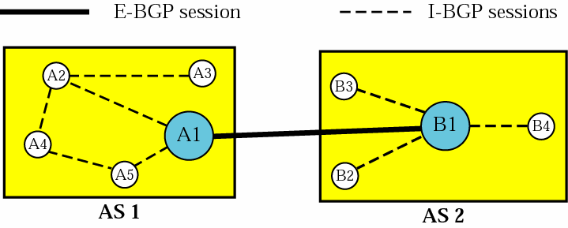
Figure :Internal and external BGP sessions
AS1 and AS2: E-BGP
I-BGP: collect information from other routers in their AS

Slide 93
Types of Packets
BGP uses four different types of messages
Open
Update
Keepalive
Notification

Slide 94
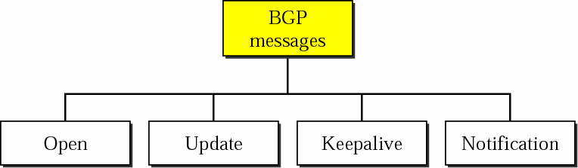
Types of BGP Messages
F
igure 13-51

Slide 95
Packet Format
All BGP packets share the same common header
Header format
Marker: 16-bytes
Reserved for authentication
Length: 2-bytes
Define the length of the total message, including the header
Type: 1-byte
Define the type of the packet

Slide 96
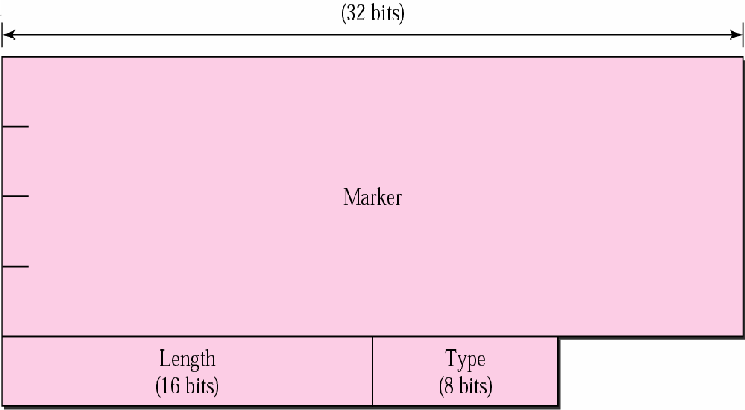
BGP Packet Header
F
igure 13-52

Slide 97
Open Message
Used to create a neighborhood relationship
A router running BGP opens a TCP connection with a neighbor and sends an open message
If the neighbor accepts
It responses with a keepalive message
The relationship then has been established between the two router

Slide 98
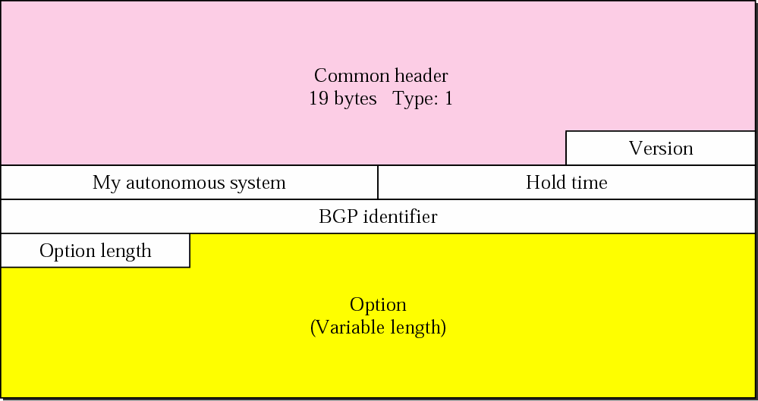
Open Message
F
igure 13-53

Slide 99
Open Message Packet Format
Version: 1-byte
Define the version of BGP. The current version is 4
My autonomous system: 2-byte
Define the autonomous system number
Hold time: 2-byte
Define the maximum number of seconds that can elapsed before one of the parties receives a keepalive or update message from the other
If a router does not receive one of the messages during the hold period, it considers the other party dead

Slide 100
Open Message Packet Format (Cont.)
BGP number: 4-byte
Define the router that sends the open message
Option parameter length: 1-byte
Define the length of the total option parameters
□ Since open message may also contain some option parameters
Option parameters
The only option parameters defined so far is
authentication

Slide 101
Update Message
Used by a router to
Withdraw destination(route) that have advertised previously
Announce a route to a new destination
Note, a router can withdraw several destinations in a single update message
However, it can only advertise one new destination in a single update message

Slide 102
Update Message Format
Unfeasible routes length: 2-byte
Define the length of the next field
Withdraw routes
List all routes that should be deleted from the previously advertised list
Path attributes length: 2-byte
Define the length of the next field
Path attributes:
Defines the attributes of the path (route) to the network
whose reachability is being announced in this msssage

Slide 103
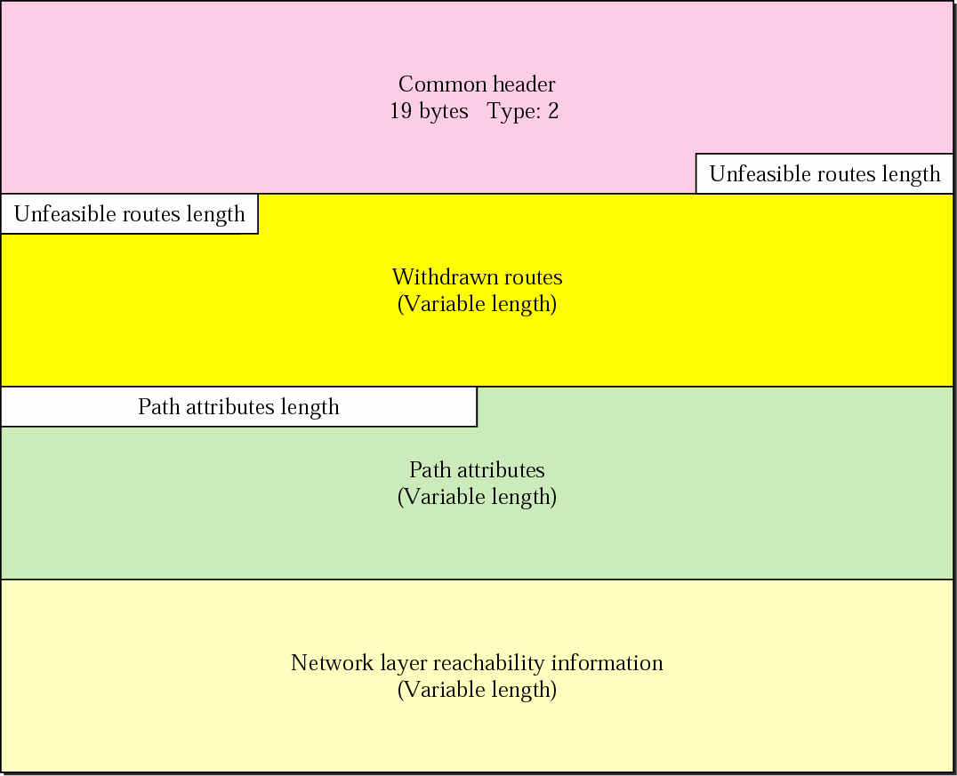
Update Message
F
igure 13-54

Slide 104
Update Message Format
Network Layer reachability information (NLRI)
Define the network that is actually advertised by this message
Has two fields
Length: define the number of bits in the prefix
IP address prefix: the common part of the network address
Example: if a network is 153.18.7.0/24
Length = 24
IP address prefix = 153.18.7
Thus, BGP4 supports classless addressing and CIDR

Slide 105

Keepalive Message
The BGP routers exchange keepalive message
regularly
Tell each other that they are alive
Format
Consist of only the common header
Keepalive Message

Slide 106
Notification Message
Sent by a router
Whenever an error condition is detected
A router wants to close the connection
Format
Error code: 1-byte, define the category of the error
Message header error
Open message error
Update message error
Hold timer expired
Finite state machine error
Cease
Error subcode: 1-byte
Furthermore define the type of error in each category
Error data
Used to give more diagnostic information about the error

Slide 107
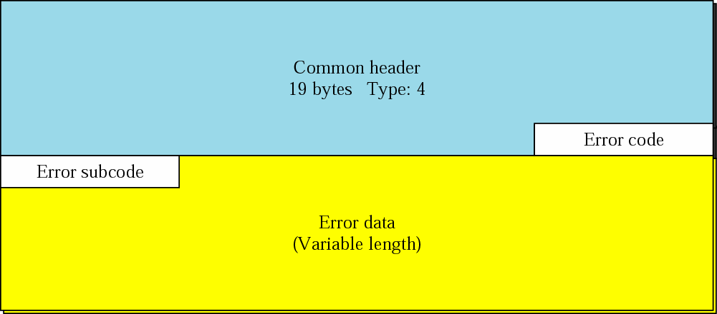
Notification Message
F
igure 13-56

Slide 108
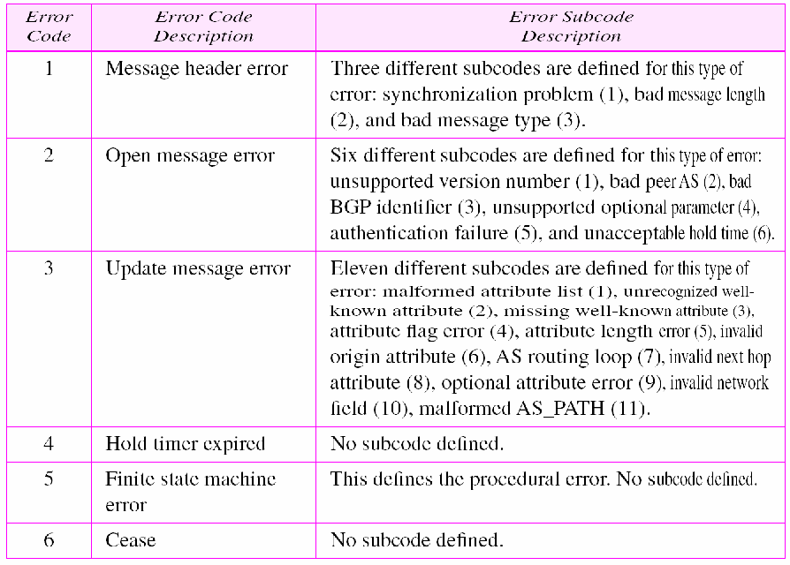
Table Error codes

Slide 109
Encapsulation
BGP message are encapsulated in TCP segments using the well-known port 179
No need for error control and flow control
Thus, when a TCP connection is opened
The exchange of update, keepalive, and notification message is continued
Until a notification message of type cease is sent

